Slide 1
ELK Project

Slide 2
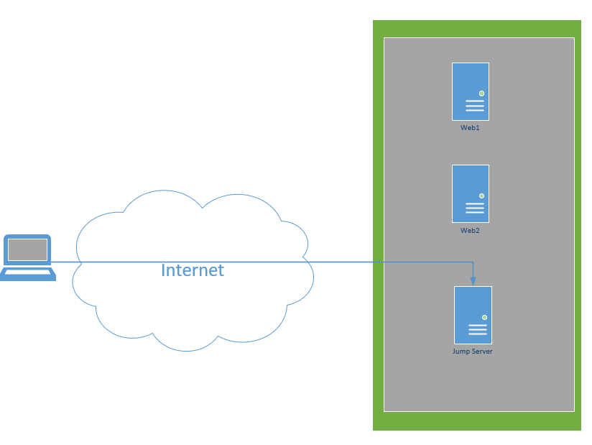
Last Class Some of You Only Gained SSH Access

Slide 3
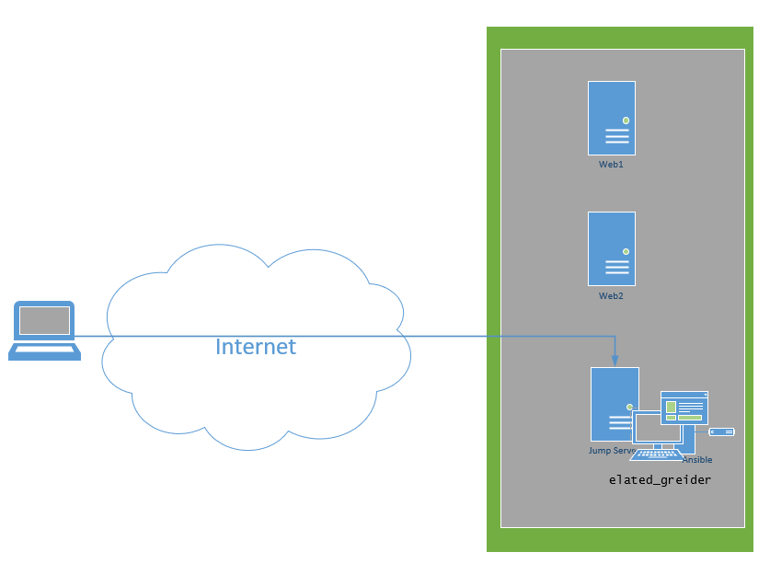
A Few of You Set Up Ansible

Slide 4
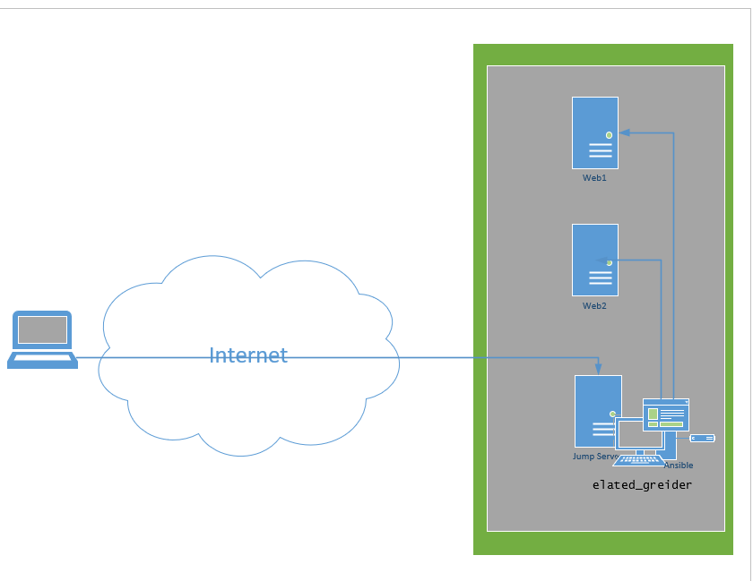
And Three of Us Connected Ansible to the Web Servers

Slide 5
Day 1 Start

Slide 6
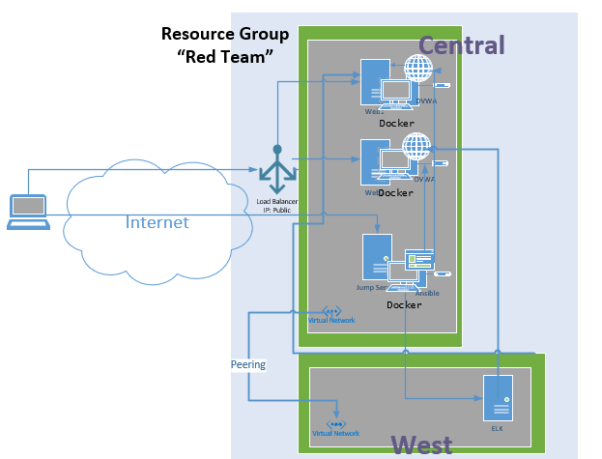
Original Project

Slide 7
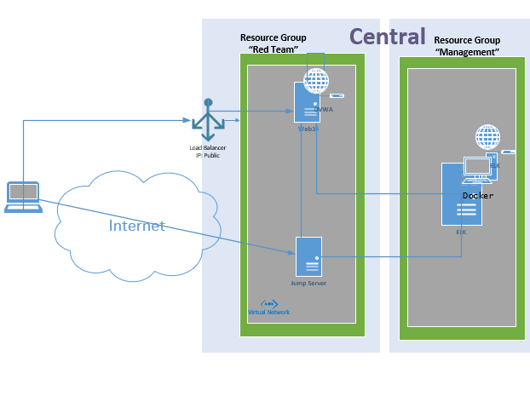
New Project

Slide 8
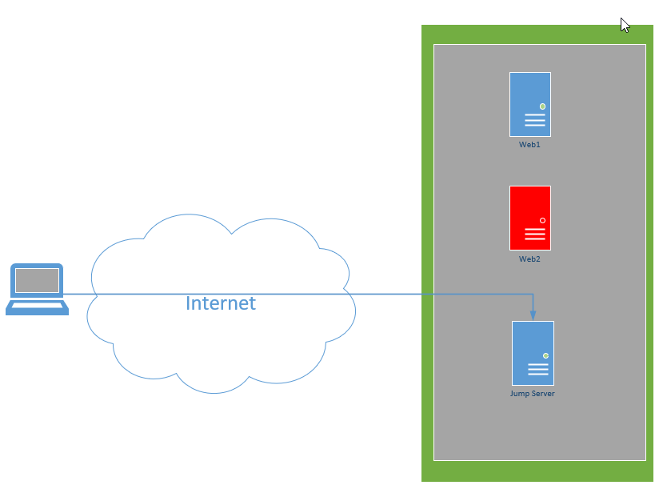
1. Forget About Ansible 2. Delete Any Containers on Web1 3. Delete VM Web 2 4. Create Usernames and Passwords for both VMs – Certs will not be used

Slide 9
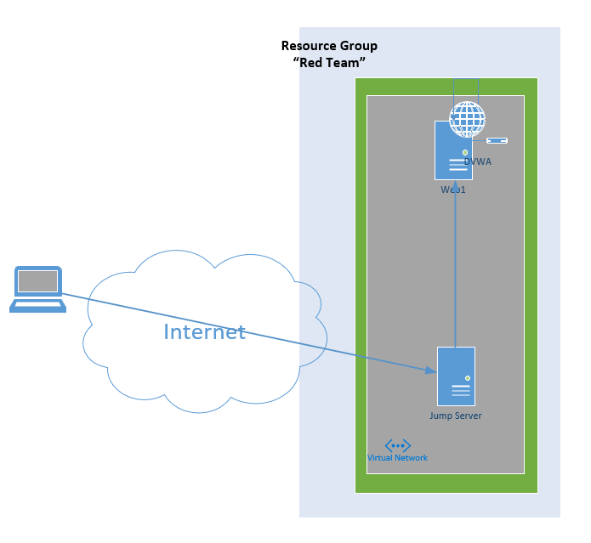
Setup DVWA

Slide 10
mv Filebeat /etc/filebeat/filebeat.yml #!/bin/bash ​ if ! [ $(id -u) = 0 ]; then echo "The script need to be run as root." >&2 exit 1 fi ​ if [ $SUDO_USER ]; then real_user=$SUDO_USER else real_user=$(whoami) fi #Check to see if user is Root # echo apt update && apt upgrade #Update and upgrade Current VM # apt install docker.io #installs docker to box # apt install python3-pip #installs python # apt install docker #installs docker python module # systemctl start docker #starts docker # docker pull vulnerables/web-dvwa #pulls docker Dvwa # docker run --rm -it -p 80:80 vulnerables/web-dvwa #Create Image #
1. SSH into the Jump Server and use it to SSH into the Web1 2. Run the DVWA Script that Terrace and Steve Created and Thank Them

Slide 11
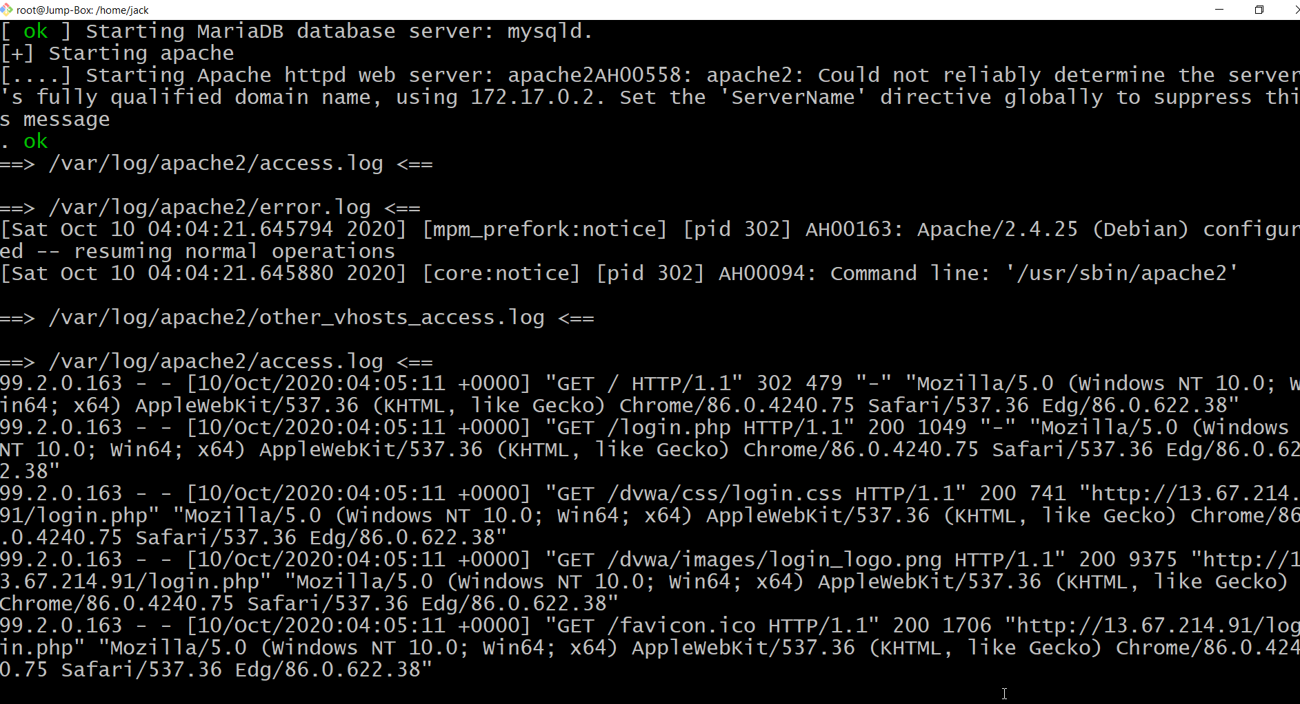
If It’s Working……

Slide 12
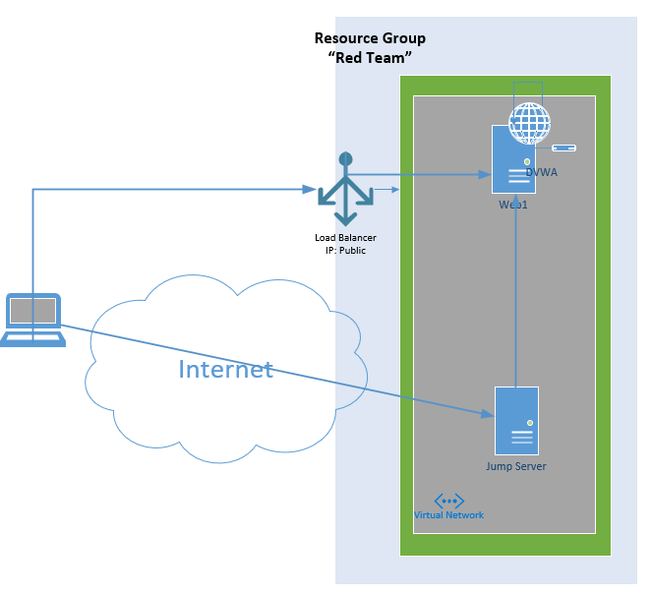
1. Create a Load Balancer and add Web01 into it 2. Open port 80 from your Load Balancer to your Web server (NSG) https://www.youtube.com/watch?v=-VMPzVoo5Nk

Slide 13
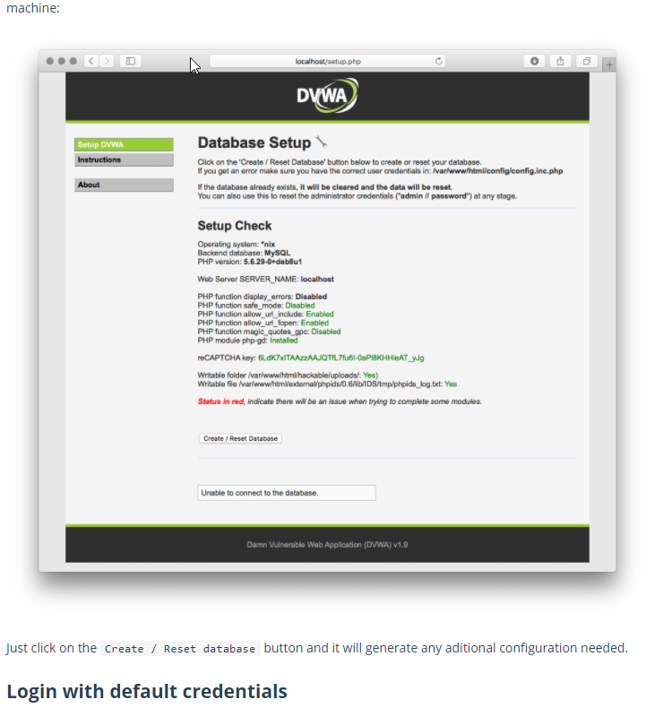
1. Test Connecting to the DVWA Using the Public IP of the Load Balancer 2. Log in following the below Instructions – Start reading where the images start, ignore everything before it https://hub.docker.com/r/vulnerables/web-dvwa

Slide 14
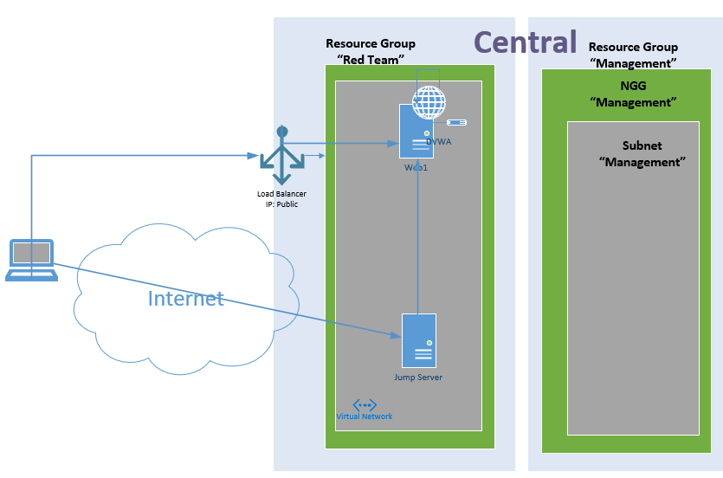
1. Create New Resource Group – “Management” 2. Create New Subnet in Existing Virtual Network 3. Create New NSG - “Management” in Management Resource Group 4. Associate NSG to “Management” Subnet 5. Move Existing VNET to New Resource Group

Slide 15
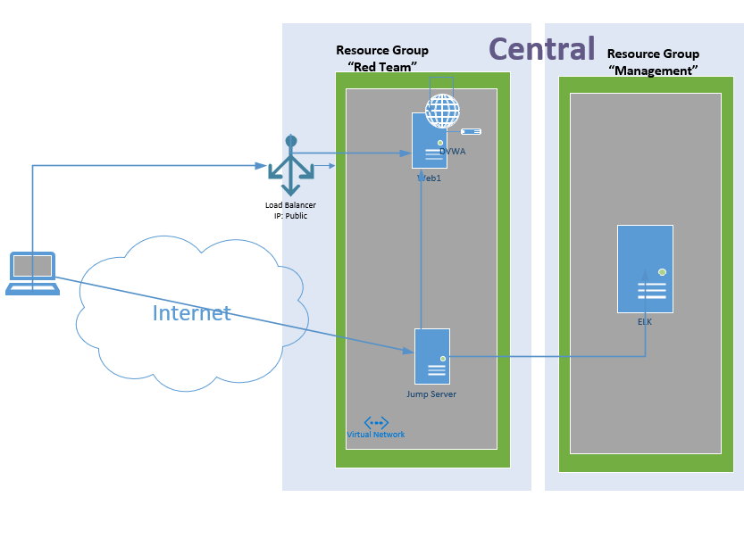
1. Create a Simple New VM, in Resource Group “Management”, Called “ELK”. Create a username and password and make sure the B series VM has 2 CPUs and 4gb of Memory Make Sure you Don’t Create a NEW NSG as part of the Setup Give it a Public IP 2. Verify you can SSH into it the new VM

Slide 16
Install ELK
#!/bin/bash
​
if ! [ $(id -u) = 0 ]; then
echo "The script need to be run as root." >&2
exit 1
fi
​
if [ $SUDO_USER ]; then
real_user=$SUDO_USER
else
real_user=$(whoami)
fi
#Check to see if user is Root
#
echo apt update && apt upgrade
#Update and upgrade Current VM
#
apt install docker.io
#installs docker to box
#
apt install python3-pip
#installs python
#
apt install docker
#installs docker python module
#
sysctl -w vm.max_map_count=262144
#increases virtual memory
#
systemctl start docker
#starts docker
#
docker pull sebp/elk
#pulls docker elk
#
docker run -p 5601:5601 -p 9200:9200 -p 5044:5044 -it sebp/elk
#Create Image
#

Slide 17
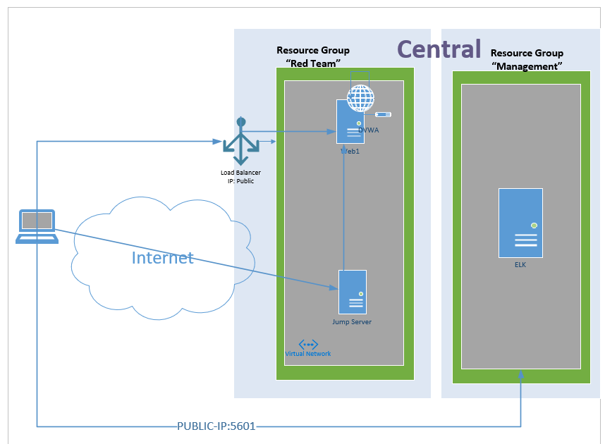
Connect to ELK and Login 1. Modify the “management” NSG to Allow your Home IP to connect to the Elk Internal IP on port 5601 2. Browse to http://Your_IP:5601/app/kibana and Login to change the default password

Slide 18
Day 1 Complete

Slide 19
Day 2 Start

Slide 20
Where We Left Off

Slide 21
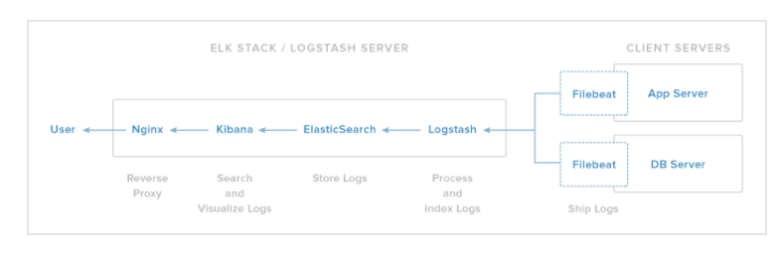
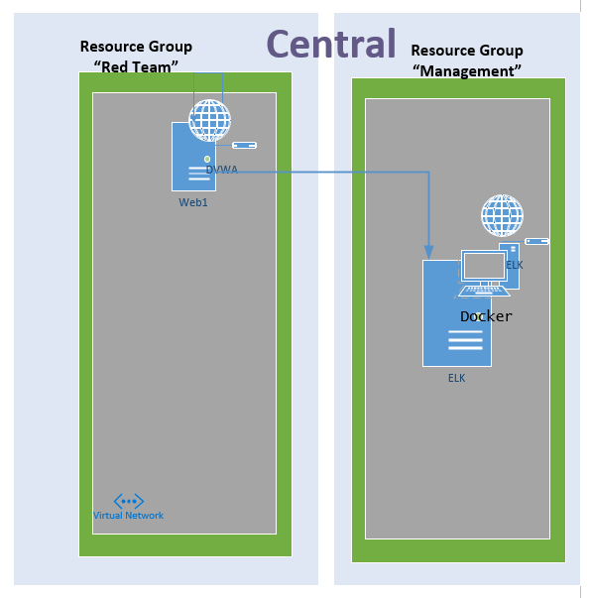
Goal Push Logs from Web01 to ELK

Slide 22
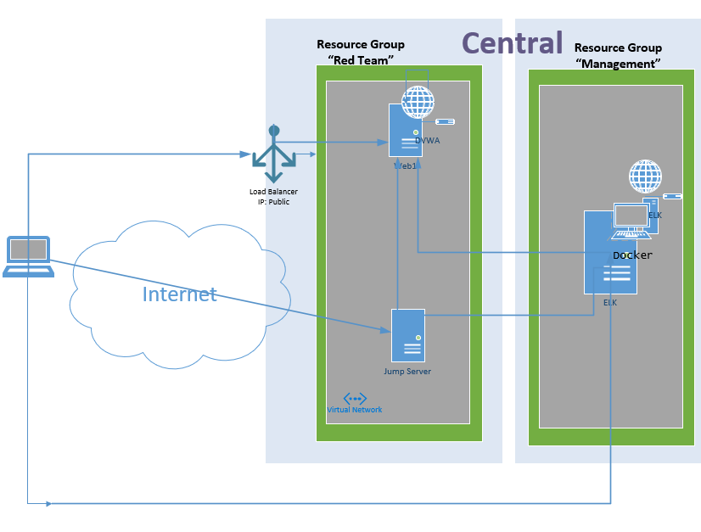
By the End of Today You Should Have

Slide 23
Install File Beat on Web Server
SSH into the Web Server through the Jumpbox
#download filebeat
curl -L -O https://ln2.sync.com/dl/18aa05e60/zkc82r7a-adqnqwrk-9in3s62h-3yyj7kug
#rename file
mv zkc82r7a-adqnqwrk-9in3s62h-3yyj7kug filebeat-6.8.12-amd64.deb
#install filebeat
sudo dpkg -i filebeat-6.8.12-amd64.deb
ref: https://www.elastic.co/guide/en/beats/filebeat/6.8/filebeat-installation.html

Slide 24
Download the Config File, Move it, and Add Dest Server
#download
curl -O –L https://gist.githubusercontent.com/slape/5cc350109583af6cbe577bbcc0710c93/raw/eca603b72586fbe148c11f9c87bf96a63cb25760/Filebeat
#move
mv Filebeat /etc/filebeat/filebeat.yml
#open
Nano /etc/filebeat/filebeat.yml
#update Config to Point to ELK Server
Scroll to line #1106 and replace the IP address with the IP address of your ELK machine. And Update Password.
output.elasticsearch:
hosts: ["10.1.0.4:9200"]
username: "elastic"
password: "changeme"
Scroll to line #1806 and replace the IP address with the IP address of your ELK machine.
setup.kibana:
host: "10.1.0.4:5601"

Slide 25
Open Port On Management NSG and Start Service
In Azure, navigate to the Management NSG and Open the needed port from Web Server to ELK = 9200
After, Start the Filebeat on the Web Server
filebeat modules enable system
filebeat setup
service filebeat start

Slide 26
Final Elk Project

Slide 27
Day 2 End

Slide 28
Day 3 Start

Slide 29
Home Work
Create a Github Repository - https://www.youtube.com/watch?v=XtCcoMd6U_4
Create and Add a Network Diagram
The Firewall Spreadsheet with access rules
The “why”

Slide 30
Day 3 End

